Slide 1
Choosing an FFT size
Previous formulas gave us one frequency component for each bin
FFT of size N has N/2+1 unique bins after accounting for symmetry
Tells us maximum number of frequency components we can represent
N time-domain samples ↔︎ N frequency-domain bins
Larger FFT → greater frequency resolution
Bins spaced more closely together in frequency: 2πk/N
Easier to resolve two closely-spaced frequency components of signal
Trade off:
Fundamental mathematical limitations
Resolving short transient events within long time window is difficult
Poor time resolution, long latency

Slide 2
Choosing a hop size
How often should we take FFT?
If we want to reconstruct signal, hop size H must be no more than FFT size N
Advantages of smaller hop sizes
More frequent time snapshots of signal
Phase of each bin advances less from one hop to next,
improving frequency estimation
Some window types need hop size N/2, N/3 or even less to reconstruct signal
Lower latency for phase vocoder effects
Disadvantages of smaller hop sizes
More computationally expensive
Hop sizes that aren’t integer division of FFT size can lead to reconstruction artifacts
H = N
H = N/2
H = N/4

Slide 3
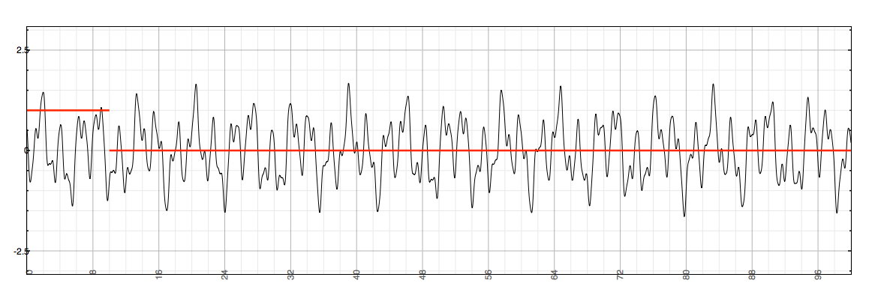
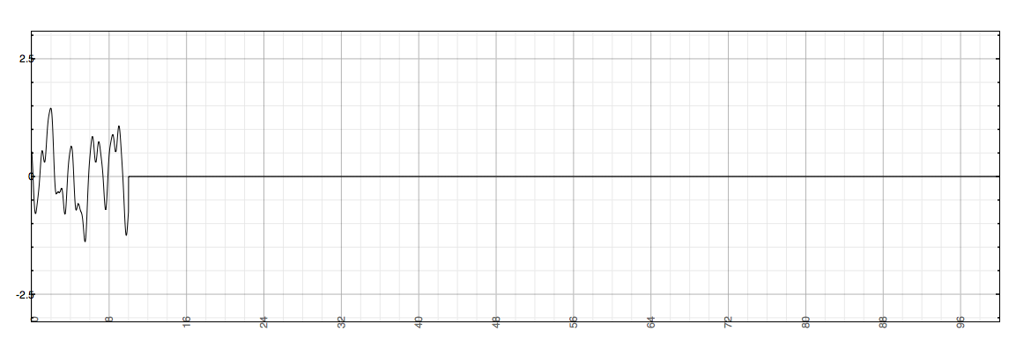
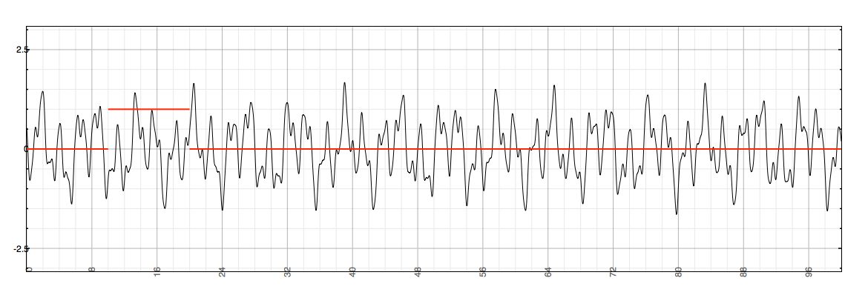
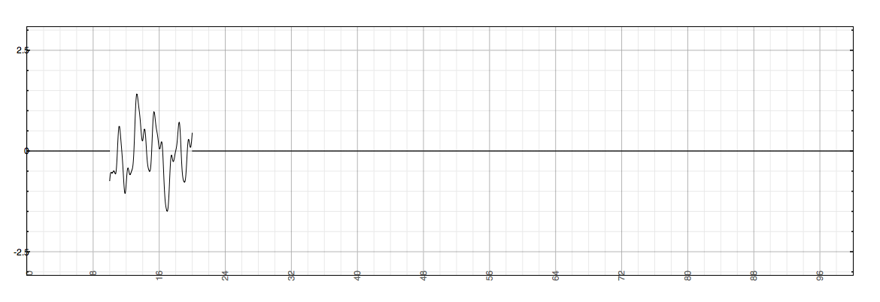
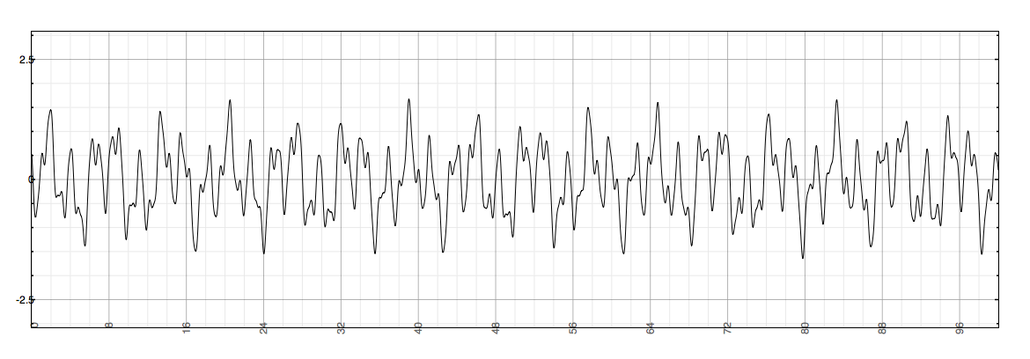
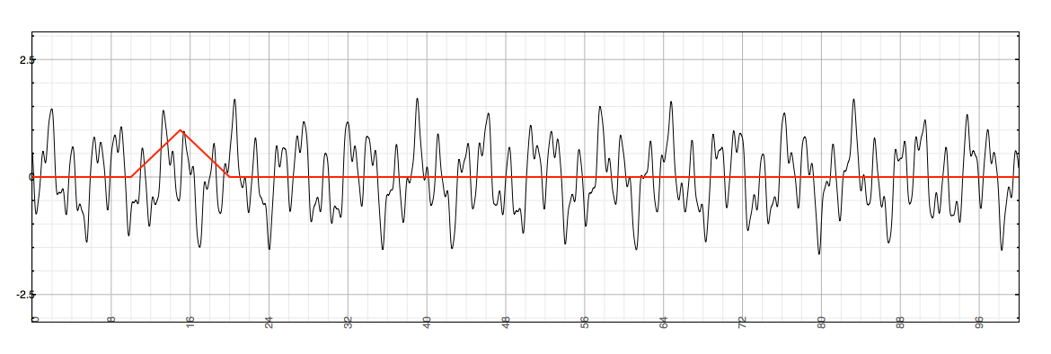
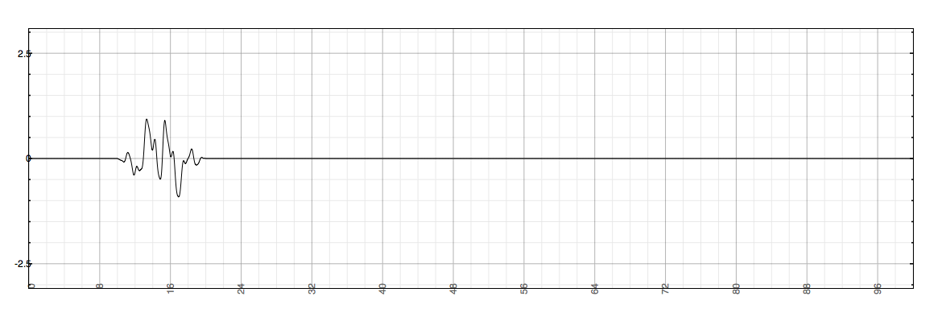
Windowing
Want instantaneous snapshot of frequency content
Look at short slice of input signal
Multiply by nonzero function for fixed length M before taking DFT
segments can have discontinuities at edges (assuming 0 outside the window)
use window function to taper edges
Can reconstruct windowed signal from DFT length N as long as N ≥ M

Slide 4
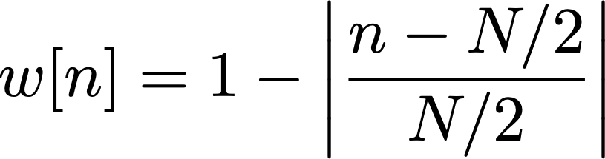


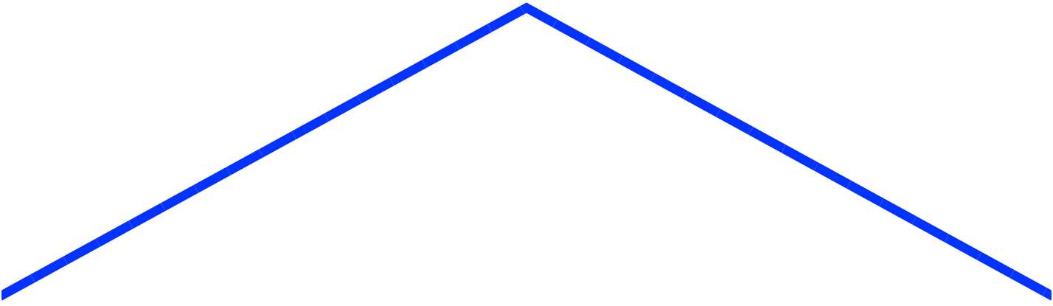
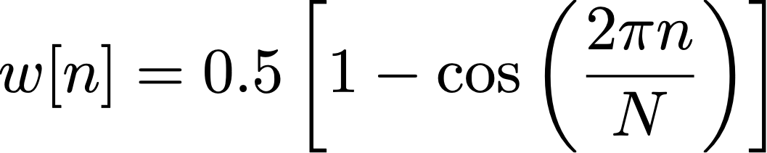
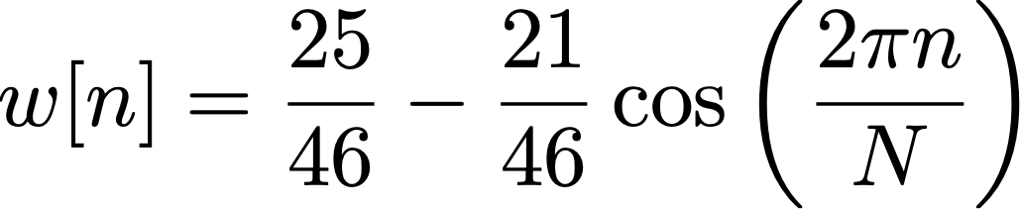
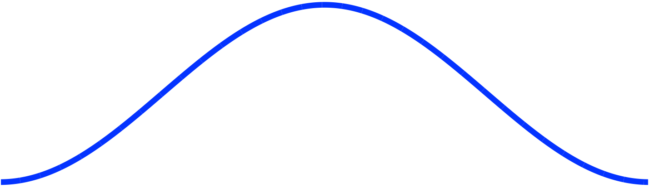
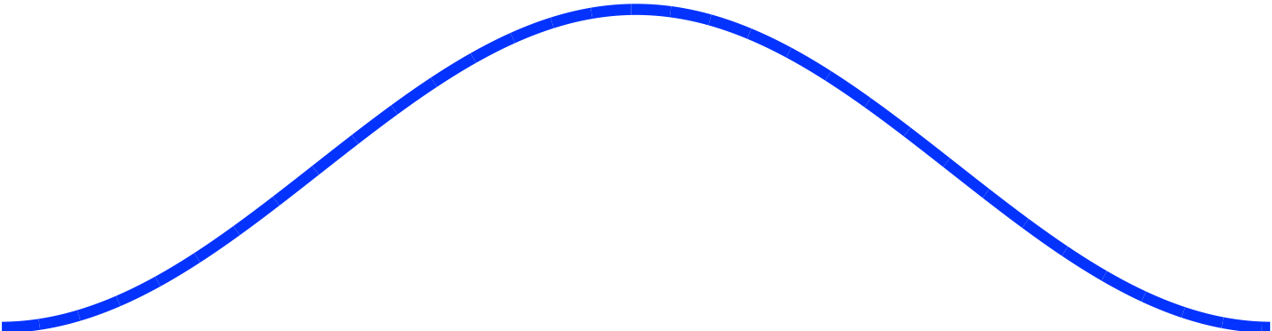
Window functions
Rectangular
Triangular (Bartlett)
for
Hann
Hamming
Pre-calculate window at program start
Multiply signal frame by window buffer
const int windowSize = 1024;
for (n = 0; n < windowSize; n++) windowBuffer[n] = [Window equation]
for (n = 0; n < windowSize; n++)
windowedSignal[n] = originalSignal[n] * windowBuffer[n];

Slide 5
Effect of rectangular window and Hann window applied to signal

Slide 6
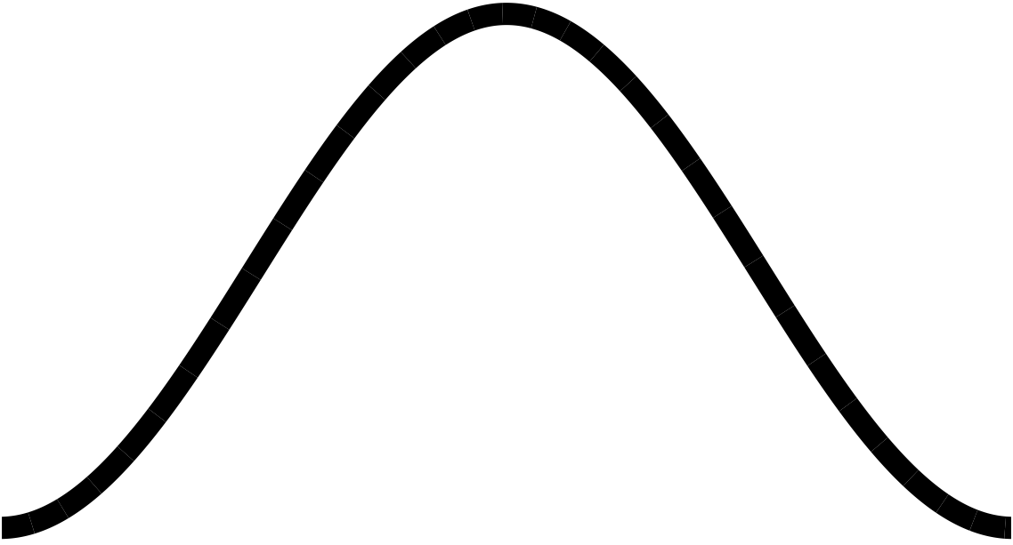
Constant Overlap-Add (COLA) criterion
May want to exactly reconstruct signal we transformed to frequency domain
works only for some combinations of window function & hop size
Constant Overlap-Add (COLA) criterion:
Windows of length W, added together with hop size H, must sum to constant
For rectangular windows: H = W, W/2, W/3, W/4, ...
i.e. any integer division of window size
For Hann, Hamming, Barlett: H = W/2, W/3, W/4, ...
i.e. divisions at most half window size

Slide 7
Constant overlap-add criterion (COLA)
overlapped window functions must add to constant
Holds on top,
but not bottom plot

